Slide 1

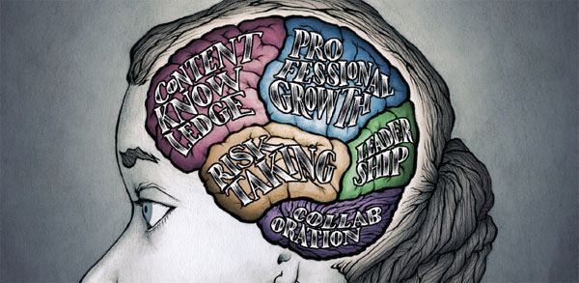


Teachers & teacher content knowledge in SA
Finding a way forward
www.nicspaull.com/presentations
CPLO Roundtable on Teachers | 13 October 2014

Slide 2
Outline
An axiomatic approach to talking about teachers
Framing: The SA education system
Focusing on teachers
  Teacher content knowledge
  Teacher training (esp in-service teacher training)
  The need to differentiate
Some thoughts on the way forward

Slide 3
An axiomatic approach:
Teachers exist because we care about learning
The teaching profession does not have an independent reason to exist (i.e. independent of students learning).
It should not exist ‘for its own sake’
It is not an employment agency.
It is not a voting bloc for hire.
It serves a function and gains legitimacy by serving that function.
It exists because we care about learning/education and teachers are an essential & integral part of learning/education.
Given the above the correct thing to focus on when discussing teachers is student learning – how do we improve and increase the ‘quality’ of what students learn and ‘volume’ of what they learn.
Schooling is essentially about (1) the student, and (2) the teacher in the presence of (3) content. (ala Elmore 2008)
In all of our discussions around teachers we must keep in mind that the end goal is the STUDENT, not the teacher (although the teacher is often an ‘intermediate end-goal’, but not final end-goal). #perspective

Slide 4
Framing: The SA education system

Slide 5
Inequality: Two public schooling systems

Slide 6
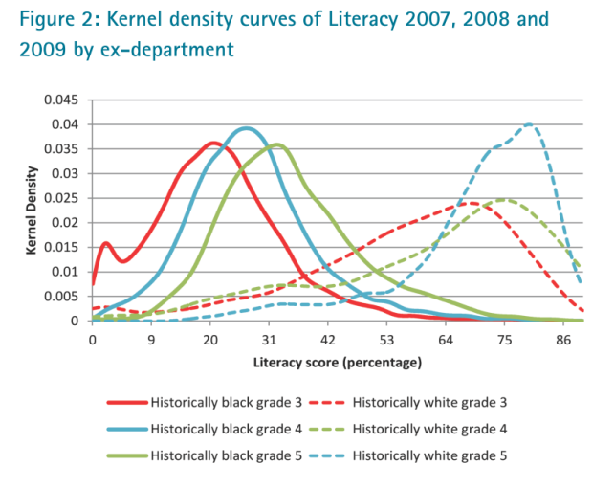
Bimodality – indisputable fact
PIRLS / TIMSS / SACMEQ / NSES / ANA / Matric… by Wealth / Language / Location / Dept…

Slide 7
Labour Market
17%
Legislators, managers, assoc professionals
Unemployed
(Broad - 33%)
Unskilled
(19%)
Elementary occupations & domestic workers
Semi-Skilled (31%)
Clerks, service workers, shop personnel, skilled agric/fishery workers, plant and machinery operators)
University/FET
Type of institution (FET or University)
Quality of institution
Type of qualification (diploma, degree etc.)
Field of study (Engineering, Arts etc.)
High productivity jobs and incomes (17%)
Mainly professional, managerial & skilled jobs
Requires graduates, good quality matric or good vocational skills
Historically mainly white
High quality secondaryschool
High SES background
+ECD
High quality primary school
Minority (20%)
Some motivated, lucky or talented students make the transition
Unequal society
Big demand for good schools despite fees
Some scholarships/bursaries
Vocational training
Affirmative action
Majority (80%)
Quality
Low quality secondary
school
Attainment
Type
Low productivity jobs & incomes
Often manual or low skill jobs
Limited or low quality education
Minimum wage can exceed productivity
Low SES background
Low quality primary school
cf. Servaas van der Berg – QLFS 2011
Notes:
The QLFS classifies professions as follows: Highly skilled (legislators, senior officials and managers, professionals, technicians and associate profesionals); Semi-skilled (Clerks, service workers and shop and market personnel, skilled agricultural and fishery workers, craft and related trade workers, plant and machinery operators and assembly), Unskilled (Elementary occupations, domestic workers).

Slide 8
Overview of education in SA
12.4m students
  4 % of students are in independent schools (i.e. 96% public)
25,826 schools
  6% of schools are independent schools (i.e. 94% public)
425,000 teachers
  8% of teachers are in independent schools (i.e. 92% public)
Near universal access up to Grade 9 (quality?!)

Slide 9
From an expenditure point of view it makes sense to look at teachers (3-5% GDP) Expenditure on education 2010/11
Total government expenditure
(31% GDP in 2010/11 – R733.5bn)
Government exp on education
(19.5% of Gov exp: R143.1bn)
17%
5%
Notes:
Figures from 2012 Public Expenditure Analysis report for UNICEF/DBE (Oxford Policy Management / Stellenbosch Economics) Education exp = 6.1% of GDP
Personnel exp = 78% of educ exp
Personnel exp = 4.8% of GDP

Slide 10
Union membership

Slide 11
Looking at primary school maths teachers (Gr 6) specifically…

Slide 12
Teacher content knowledge
Taylor & Vinjevold (1999, p. 230) summarize the 54 studies that made up this initiative and conclude as follows: “The most definite point of convergence across the [President’s Education Initiative] studies is the conclusion that teachers’ poor conceptual knowledge of the subjects they are teaching is a fundamental constraint on the quality of teaching and learning activities, and consequently on the quality of learning outcomes.”
Carnoy & Chisholm (2008, p.33): “The relatively low level of mathematics knowledge that teachers have in all somewhat troubling. It raises some doubts about the preparation of the teacher forcebut the highest student [socioeconomic status] schools is”.
Taylor & Taylor (2013, p. 230): “The subject knowledge base of the majority of South African grade 6 mathematics teachers is simply inadequate to provide learners with a principled understanding of the discipline…providing teachers with a deep conceptual understanding of their subject should be the main focus for both pre- and in-service teacher training”.

Slide 13
New (2014) research on mathematics teacher content knowledge
Using SACMEQ 2007 teacher test, Venkat & Spaull classify the 42 items in the SACMEQ maths teacher test according to content strand and grade level
  9 items at Gr4/5 level
  19 items at Gr6/7 level
  14 items at Gr 8/9 level
Classify teachers based on grade-level using a 60% minimum mark requirement for threshold
  Less than grade 4/5 content knowledge
  Grades 4 & 5 content knowledge
  Grades 4, 5, 6 ,7 content knowledge
  Grades 4, 5, 6, 7, 8 and 9 content knowledge
  *Given that the test items were structured in MCQ format all responses were corrected using Frary’s correction formula

Slide 14
Forthcoming work on primary school mathematics teachers in SA (Spaull & Venkat, 2014)
Figure 1: Proportion of South African grade 6 mathematics teachers by content knowledge (CK) group - SACMEQ 2007 (with 95% confidence interval) [401 Gr6 maths teachers]
Notes:
http://www.ekon.sun.ac.za/wpapers/2014/wp132014

Slide 15
Primary school mathematics teachers in SA
(Venkat & Spaull, 2014)
Figure 4: Average percentage correct on all 42 items in SACMEQ 2007 mathematics teacher test by quintile of school socioeconomic status and school location (corrected for guessing) [401 Gr6 maths teachers]

Slide 16
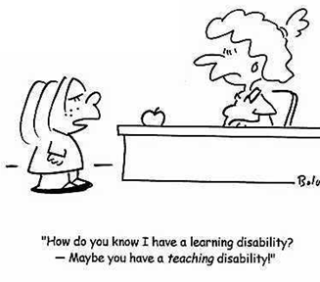
Primary school mathematics teachers in SA
(Venkat & Spaull, 2014)
Figure 5: Proportion of Grade 6 mathematics teachers by CK grouping and quintile of school socioeconomic status (SACMEQ 2007) - with 95% confidence intervals [401 Gr6 maths teachers]

Slide 17
Teacher knowledge
Teachers cannot teach what they do not know.
Content knowledge – How to do fractions
Pedagogical content knowledge– how to teach fractions
Student understands and can do fractions
Demonizing teachers is popular, but unhelpful
“For every increment of performance I demand from you, I have an equal responsibility to provide you with the capacity to meet that expectation. Likewise, for every investment you make in my skill and knowledge, I have a reciprocal responsibility to demonstrate some new increment in performance” (Elmore, 2004b, p. 93).
Notes:
Elmore, R. (2004b). School reform from the inside out: Policy, practice and performance. Cambridge, MA: Harvard Education Press.

Slide 18
IN-service vs PRE-service
teacher training/development
Don’t focus only, or primarily, on initial teacher-ed (cue opposition from the folk in ed-faculties ☺)
You cannot improve the quality of teaching unless we somehow improve the quality of existing teachers and existing teaching practices
Useful to think about STOCK vs FLOW of teachers…

Slide 19
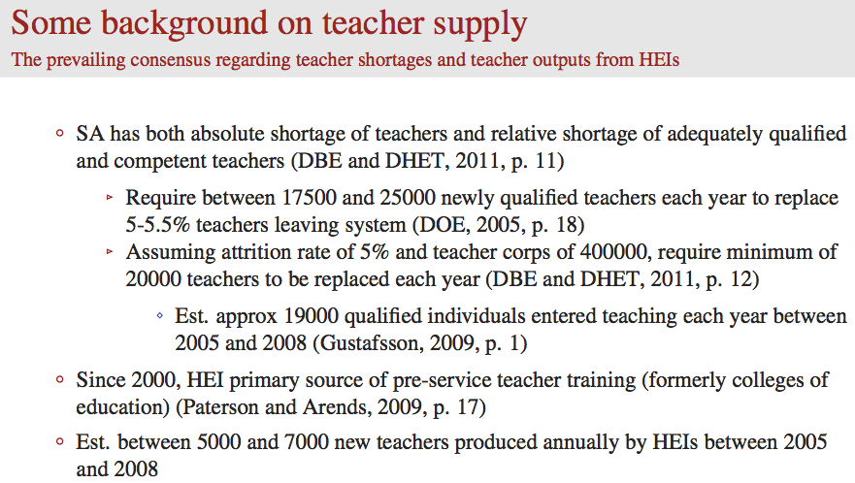
From Hendrik van Broekhuizen (ongoing research)

Slide 20
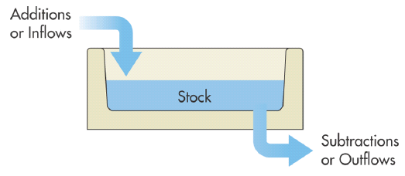
‘Stock’ vs ‘Flow’ of teachers in SA
New teachers (B.Ed)
New teachers (PGCE)
New teachers (foreigners)
New teachers (unregistered)
← Martin Gustafsson estimated that 19 100 qualified educators joined the education system annually between 2005 and 2008
5%
In 2012 there were 425,167
teachers
(Education Statistics 2012, p4)
If we don’t crack the issue of in-service teacher development in the next 20 years (i.e. providing existing teachers with meaningful learning opportunities) we are basically “screwed”
Teachers retiring
Teachers moving into other professions
Teachers immigrating
Teachers dying
Notes:
http://www.education.gov.za/LinkClick.aspx?fileticket=U%2bEemf%2boy2g%3d&tabid=93&mid=2399&forcedownload=true

Slide 21

(1b) Find substance and reject form
  If we want to make headway with teacher development (which is in everyone’s interests) we need to be basing interventions on reliable evidence NOT on politics or fads or what looks good on paper
  Nothing is properly evaluated. Evaluation is always an after-thought in education. Imagine if we used the same logic in health “This treatment for cancer looks great on paper, let’s do it”, “This homeopathic remedy worked for my cousin’s daughter so let’s roll it out to the whole country”
  We currently don’t know what works when it comes to in-service teacher training programs. Maybe we know what works in those 5 schools with that one inspirational manager and those few academics in that one circuit, but no one knows what works at anything like scale (circuit+). No one. Not the academics (educationists or economists), not the NGOs, not DBE, not the unions, not GPLMS, not LITNUM, not Pearson, not NEEDU. No one.

Slide 22
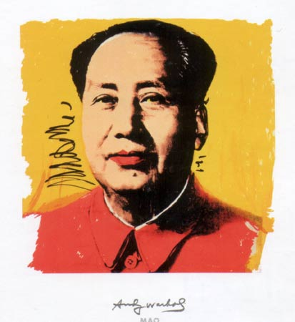
(1b) Commitment to substance not form
Evaluation is key – unless we are evaluating what we are doing we don’t know if it works. We are scattering bricks in a room as opposed to building a wall. We should only ever take things to scale IF they have been evaluated and shown to be effective in various settings and at various scales (ala Borko).
Identify master-teachers – To improve the quality of teachers currently in schools we need a small army of high-quality teacher-trainers (GPLMS?).
  We have to find a way of identifying master-teachers and create the institutional frameworks to give them time and incentives to develop programs that help teachers.
  There are brilliant teachers in all different types of schools but we currently have no idea who they are or where they are
  Serves the dual purpose of giving prestige (and benefits) to excellent teachers AND they are our best bet if getting out of the quagmire (not academics or NGOs or government)
“Let a thousand flowers bloom”

Slide 23
(2) Need to be more nuanced when talking about “teachers”
There are large inter-provincial and inter-quintile differences in school practices…but also intra-province and intra-quintile differences → need to differentiate

Slide 24
School practices
How often do you send pupils home when the teacher is absent? (SACMEQ 3)
(S Taylor, 2011)

Slide 25
School practices
How often do you leave pupils on their own when the teacher is absent? (SACMEQ 3)
(S Taylor, 2011)

Slide 26
School practices
How often do you substitute an absent teacher with a qualified teacher? (SACMEQ 3)
(S Taylor, 2011)

Slide 27
Teacher absenteeism
SACMEQ III (2007)
What is the distribution of teacher (self-reported) absenteeism across school SES quintiles?
See 2010 HSCR report on Khulisa Consortium Audit data → Mondays and Fridays and 1-2 day leave instances make up vast majority

Slide 28
(2) Averages are uniquely misleading in SA
Talking about “South African teachers” isn’t that meaningful/helpful and in many instances is downright misleading
Irrespective of your views about differential teacher pay we have a serious need for differentiating between teachers (in discussion, in the media, in analysis).
  To attract competent people into the profession these individuals need to be able to identify with a desirable sub-set of the teacher core.
  Hearts-and-minds campaign celebrating excellent/passionate/intelligent/ dedicated/self-sacrificial/empathetic/motivational teachers and differentiating them from a tainted minority. This CANNOT be a model-C vs non-model-C categorization. We have some excellent teachers in rural areas and Q1-3 schools which we should identify and hold them up as shining examples of what it means to be a teacher.
  We need to isolate and stigmatize “bad practices” rather than stigmatizing “teachers in general” which is the status quo
    These bad practices might be widespread (absenteeism, shirking etc.), or rare (rape, abuse, corruption) and in both instances we need to consistently differentiate and avoid statements like “teachers are incompetent” or “teachers are professional” – some teachers ARE incompetent but not all, and some teachers are professional but not all. We may disagree on whether we are talking about 5%, 10% or 40% but we don’t mean 100% and we don’t mean 0% can we PLEASE get away from talking about absolutes. False dichotomies help politicians not kids.

Slide 29

What does the way forward look like?
What are the tangible things that we all (and specifically EE) can do going forward regarding teachers and teaching?
Find substance and reject form in teacher training
Differentiate between teachers
Hearts and minds campaign
Everyone needs to come to the table and play ball → can’t afford to keep going with the stalemate that we have (no DG for 2 years?! WTF?)

Slide 30
Thank you
Comments?
This presentation and papers available online at: www.nicspaull.com/research

